Slide 1
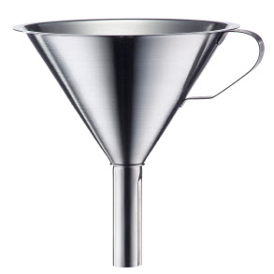

Lecture 10
Chemical Engineering for Micro/Nano Fabrication

Slide 2
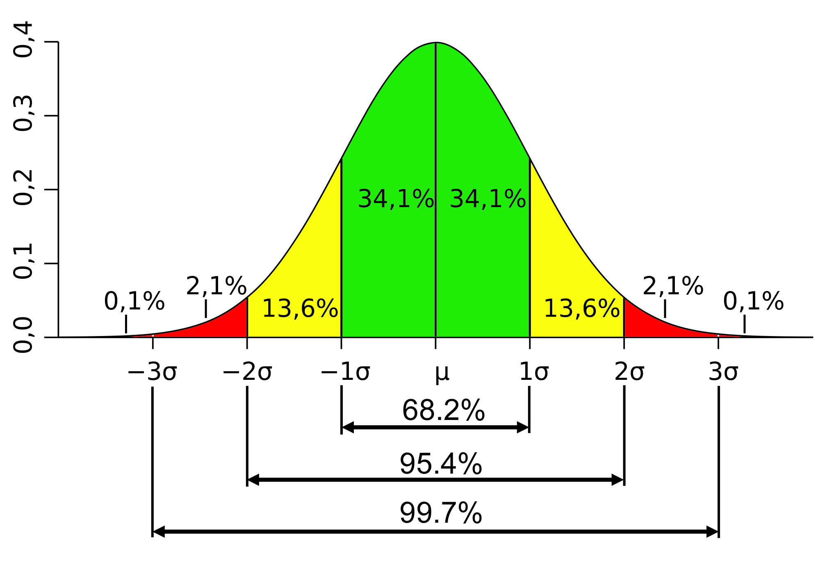
Standard Normal Distribution

Slide 3
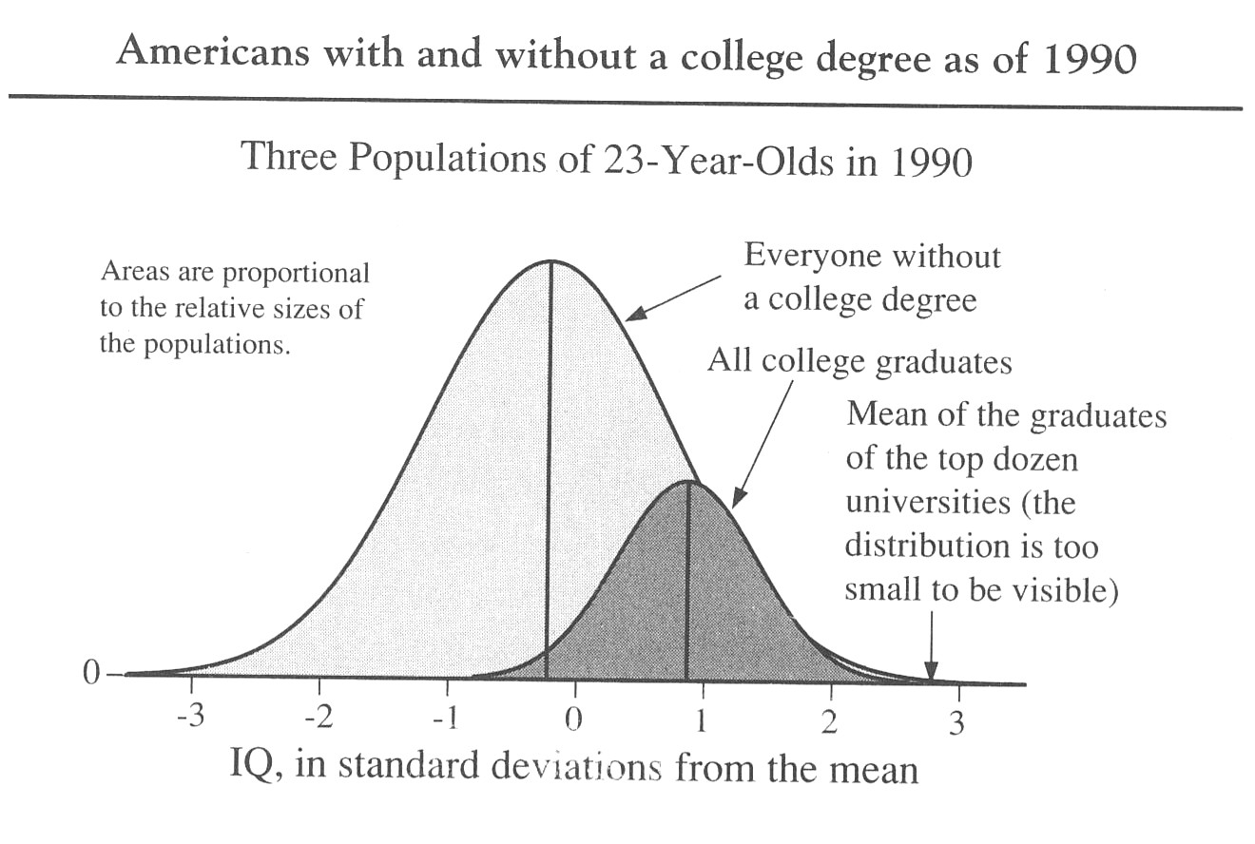
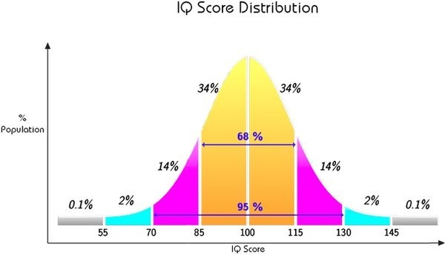
IQ score distribution

Slide 4
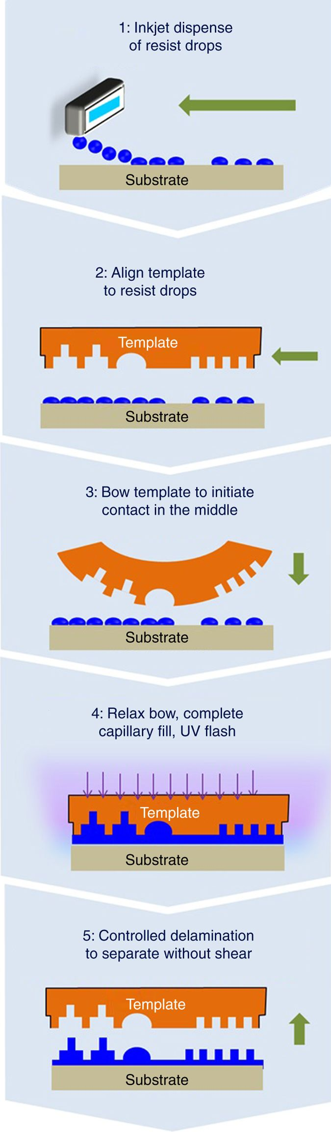
The Fill Step….the rate limiting step

Slide 5
The Fill Step….the rate limiting step

Slide 6
The Fill Step

Slide 7
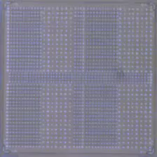

Nanofluidics: RLT Control and High Throughput
High density
Low Density
Drop dispense addresses template geometry variation, pattern-specific directionality of flow, multi-scale fluid/solid mechanics, etc. Need to solve inverse problem.
√
Med Density
7

Slide 8

The Spreading Stops “Automatically”
Force
-
0
+
Z
Z

Slide 9
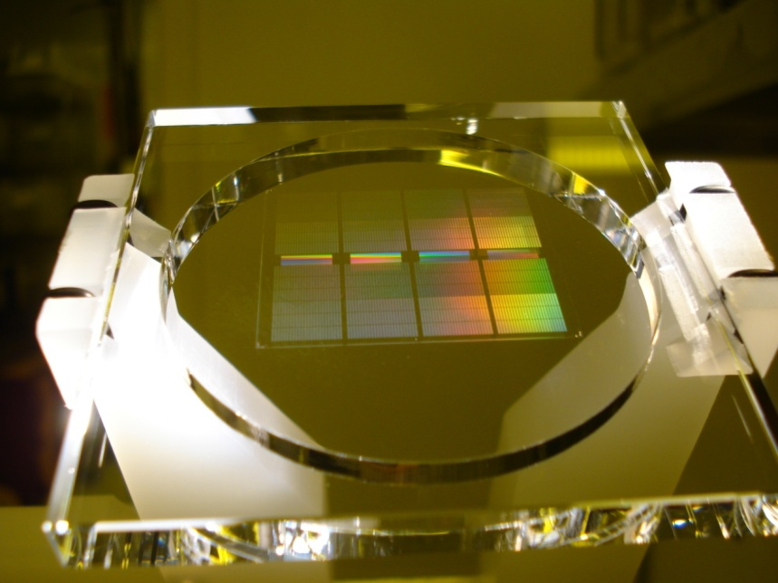
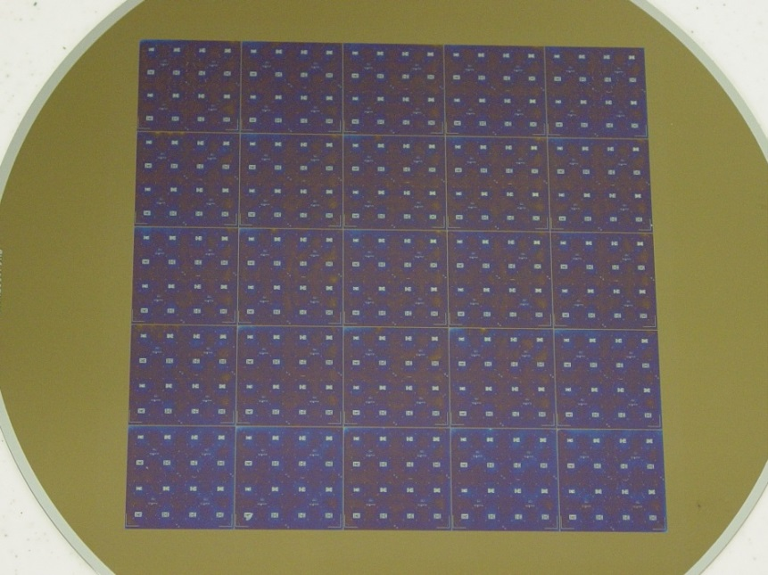
Template Mesa for Fluid Control
Nano-Scale Capillary Pinning
Nano-scale
pattern
Pattern on a 15 μm mesa

Slide 10
Separation Control
Inconsistent separation caused by poorly controlled separation mechanics causes shearing defects
Precision tool calibration and real-time control algorithms developed for controlled separation

Slide 11
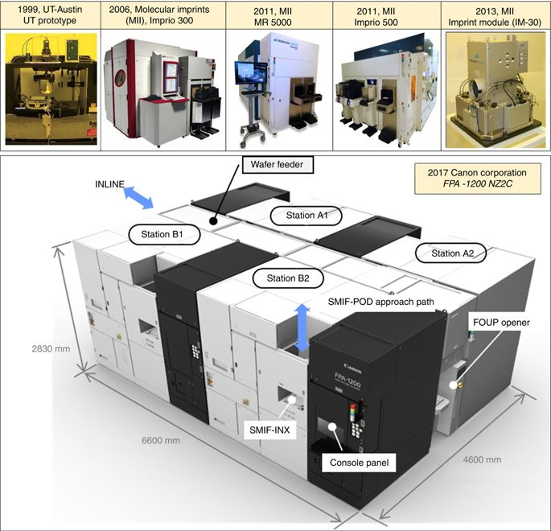
Tool Evolution

Slide 12
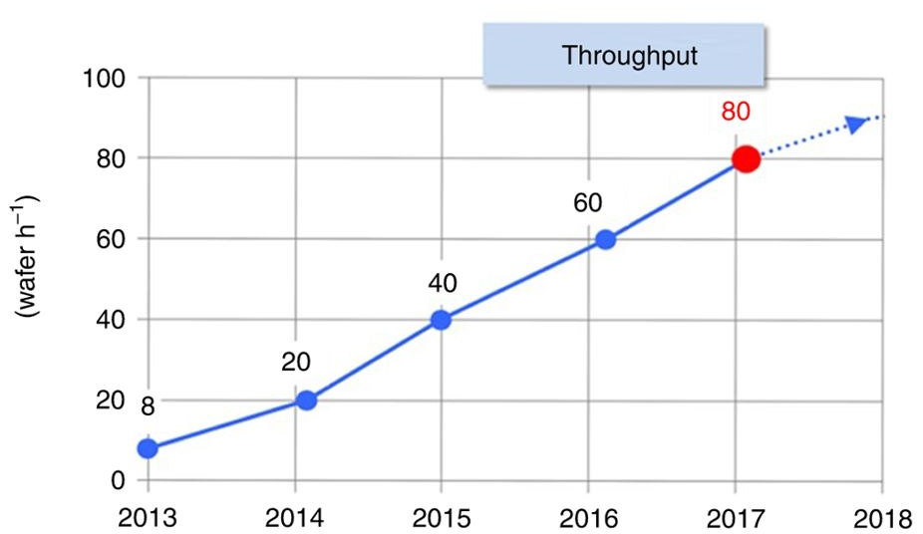
Over view of throughput achievement

Slide 13
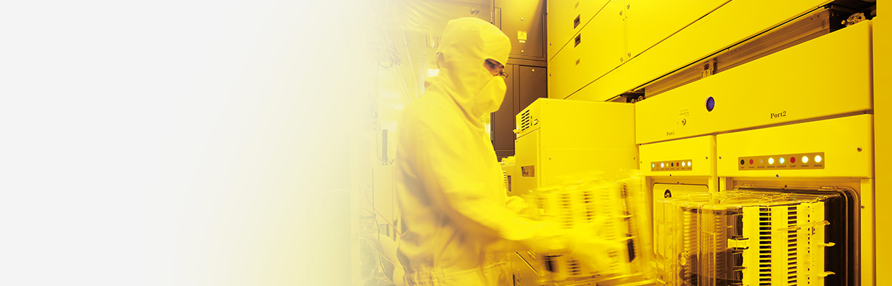





Canon, Toshiba and SK hynix going forward with SFIL
Revolutionizing the Semiconductor Industry - Nanoimprint Lithography
Report: Toshiba adopts imprint litho for NAND production
June 07, 2016 // By Peter Clarke
Toshiba will adopt nanoimprint lithography (NIL) as a way of reducing the cost of production of NAND flash memory, according to a Nikkei report. Toshiba plans to allocate part of an 860 billion yen (about $8 billion) budget for spending on semiconductors over the next three years on introducing NIL into flash memory production lines, the report said. Production is set to begin in fiscal 2017 in Yokkaichi.

Slide 14
News Release
Canon provides nanoimprint lithography manufacturing equipment to Toshiba Memory's Yokkaichi Operations plant
TOKYO, July 20, 2017—Canon Inc. announced today that the company has provided the FPA-1200NZ2C, semiconductor lithography equipment that utilizes nanoimprint lithography (NIL) technology which Canon has been continuously developing since 2004, to leading provider of semiconductor memory solutions Toshiba Memory Corporation's Yokkaichi Operations plant. The provision of this equipment represents significant progress toward semiconductor device mass production that employs nanoimprint technology.

Slide 15
What Happened To Nanoimprint Litho?
Next-gen lithography technology resurfaces for a variety of tasks.
MARCH 29TH, 2018 - BY: MARK LAPEDUS
Nanoimprint lithography (NIL) is re-emerging amid an explosion of new applications in the market……….. Toshiba installed Canon’s latest NIL system in a fab in Japan. If all goes well, Toshiba plans to use Canon’s system to pattern some of the features for its 3D NAND devices, as well as next-generation memory types in the future. Production is slated for later this year. “We hope nanoimprint will be ready for production soon,” said Tatsuhiko Higashiki, senior fellow
https://semiengineering.com/what-happened-to-nanoimprint-litho/

